Slide 1
Discover Neighborhood with Your Favorite Restaurant
Introduction
Data Requirement and Collection
Cluster the neighborhoods based on restaurant type
Result and discussion
Conclusion

Slide 2
Introduction
Often time, you get tired of the restaurants in your neighborhood. You want to try other restaurants, but you don't have a certain restaurant to go to. Where should you start? In this report, neighborhoods in Jersey City were clustered based on the restaurant-style, this can give you a guide on which neighborhoods to go that most fit your style. Don't hesitate and just follow the guidance.

Slide 3
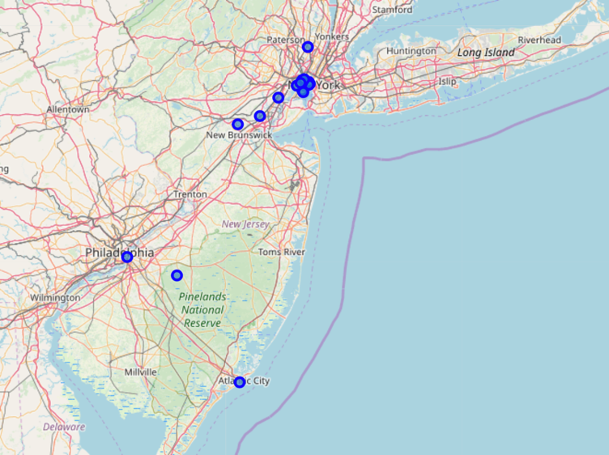
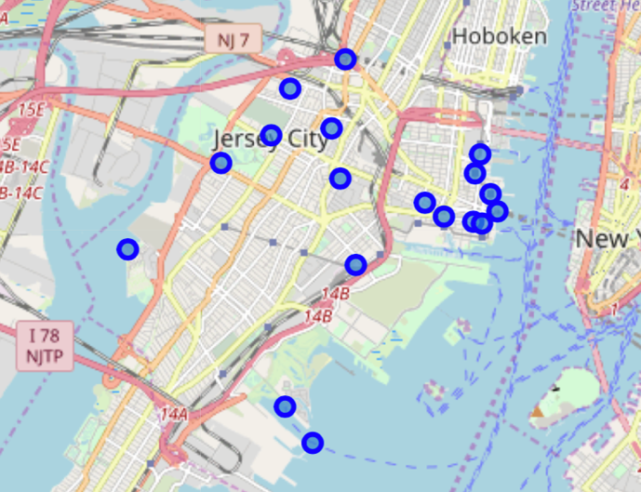
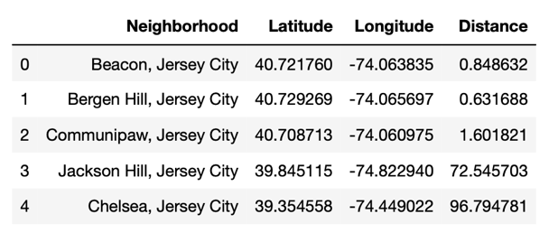
Data Requirement and Collection
Scrape information of Jersey City neighborhood from Wikipedia
Add longitude and latitude of each neighborhood
Visualize neighborhoods on the map
Before cleaning
After cleaning

Slide 4
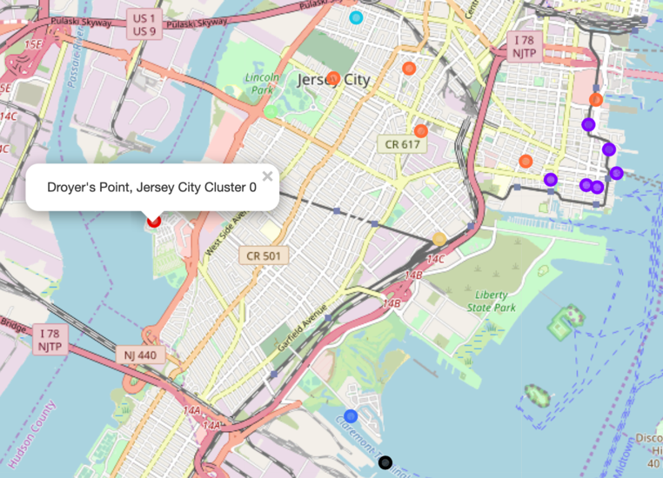
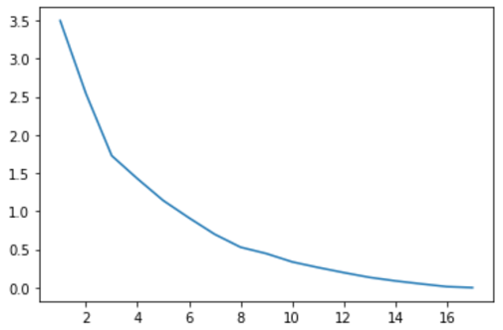
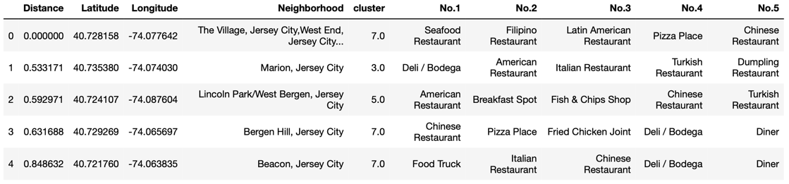
K number optimization
Clustered neighborhoods in map
Cluster the neighborhoods based on restaurant type
Clustering is conducted based on the category attributes. Categorical attributes are transformed to numerical attributes using one-hot method for clustering. The optimal cluster number is found. To better visualize the result, the top 5 most common restaurant types are organized into a new dataframe with cluster label.

Slide 5
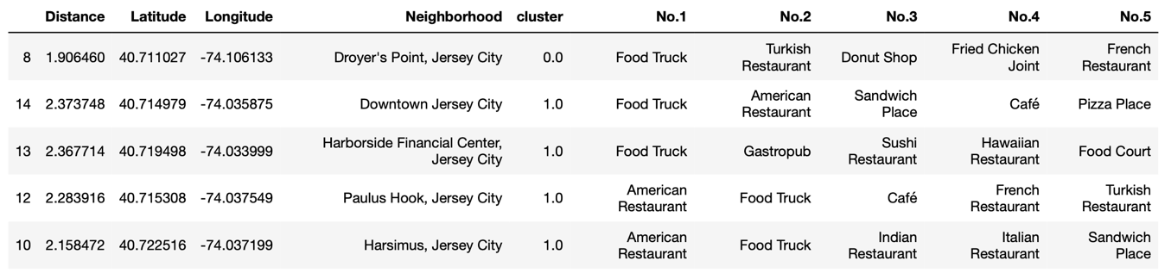
Result and discussion
As shown in the map and dataframe, cluster 1 and 7 have more than 1 neighborhood in the cluster, 6 and 5 respectively. All others only have one neighborhood. Besides, neighborhoods in cluster 1 are all located near the river in the downtown, which is also the most flourishing district. cluster 7 locates in the western area. Both neighborhoods in cluster 1 and cluster 7 are close to each other. For the other clusters who only has one neighborhood. they all located around the edge of Jersey City and each neighborhood is very far from each other. As for the top common food categories, restaurants in cluster 7 are more in Asian style including Chinese restaurants, Japanese restaurants and Thai restaurants. Restaurants in cluster 1 have more food truck and American style.

Slide 6
Conclusion
Neighborhoods that are close to each other have similar restaurant styles.
People who are interested in American food should go to neighborhoods near downtown, and people who are interested in Asian food should go to western area of Jersey City.

